Slide 1
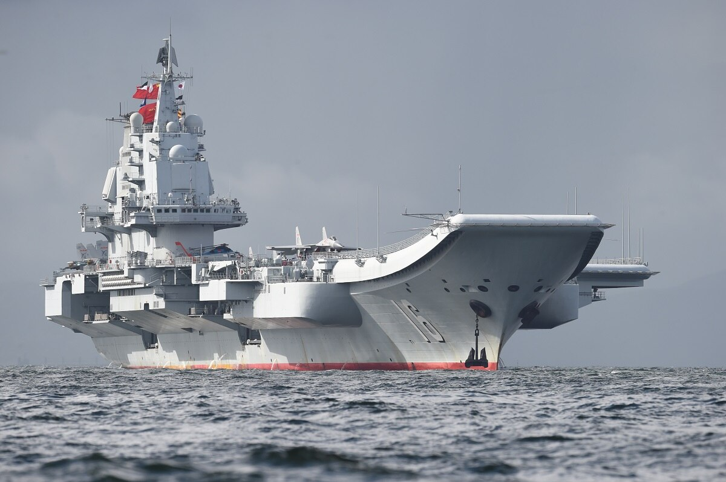
The Chinese government should expand its control over the Asia.

Slide 2
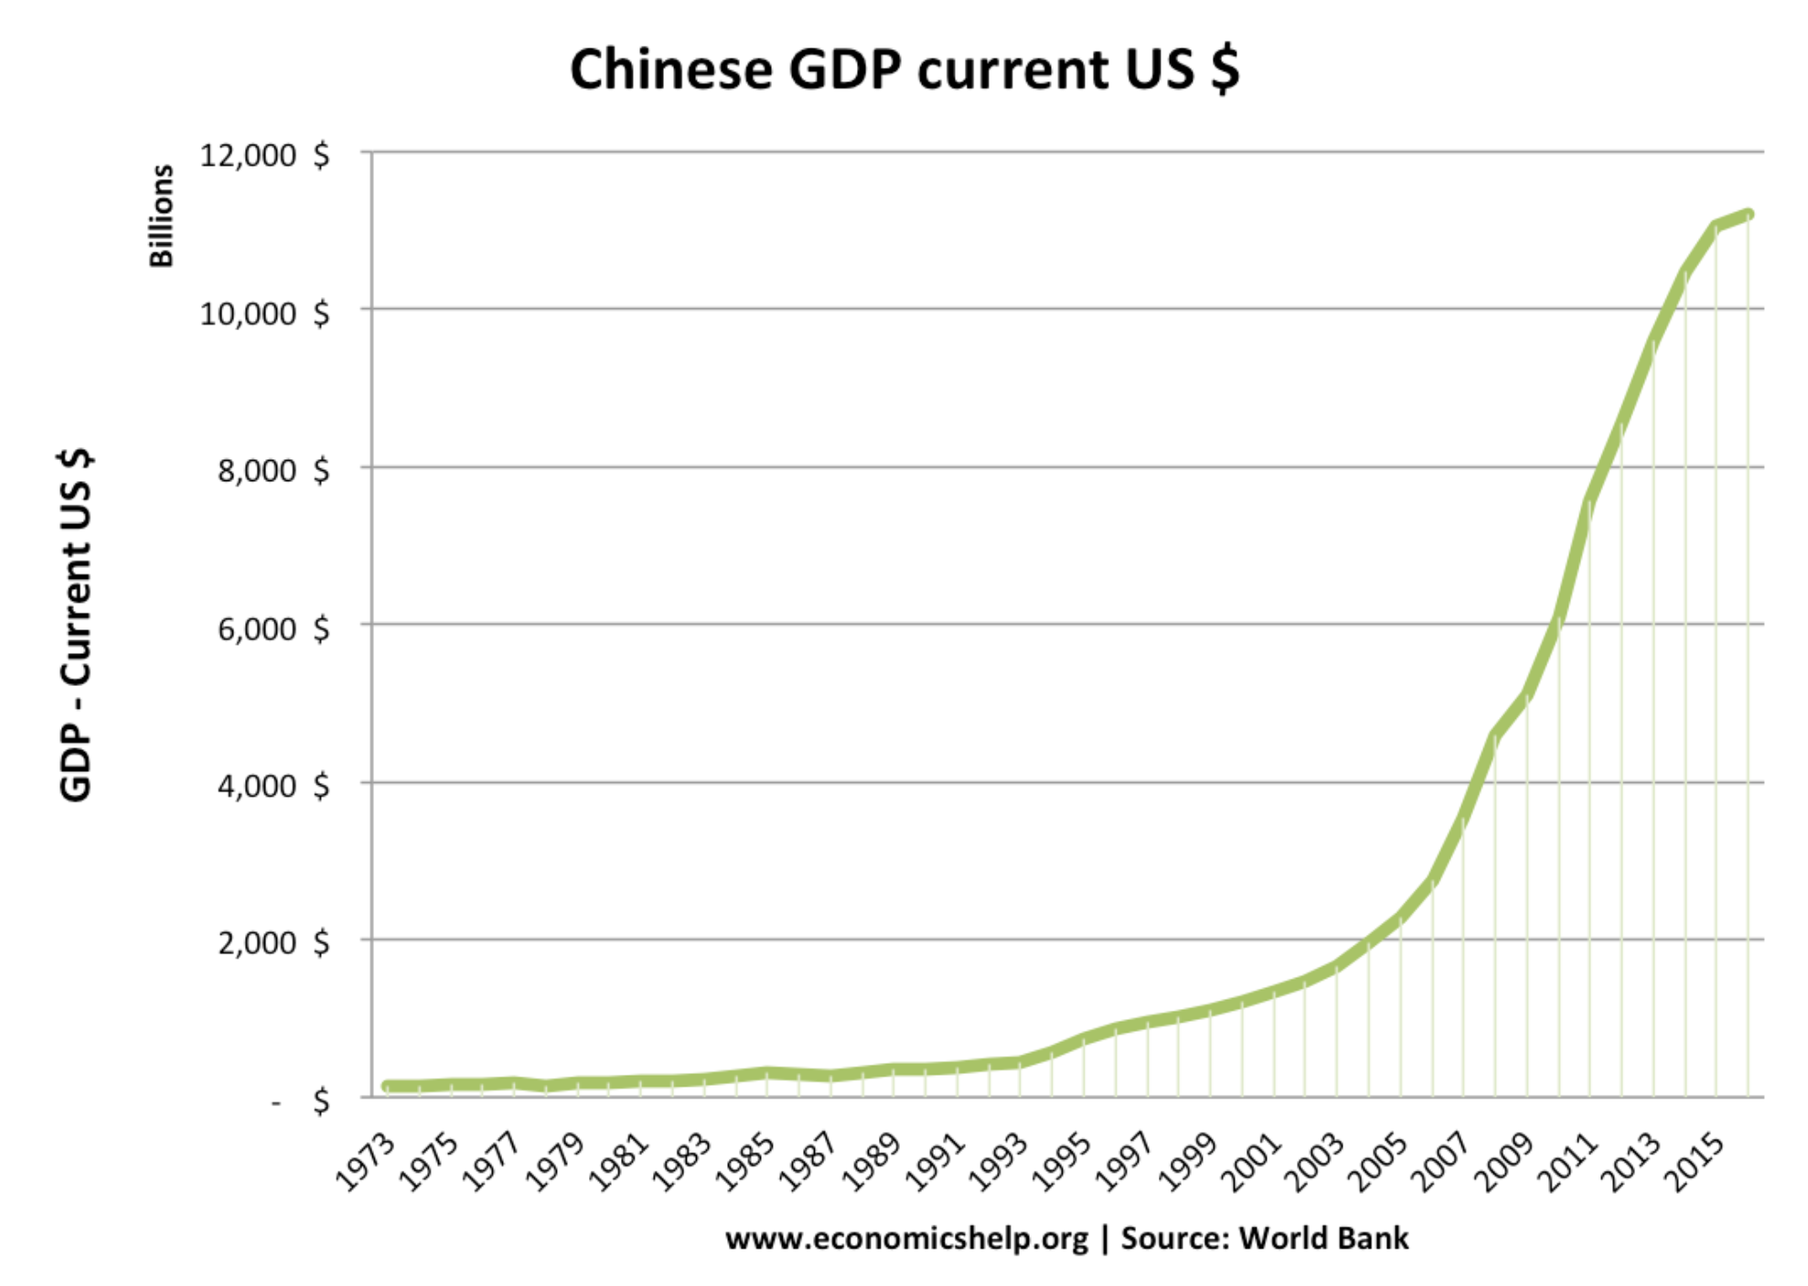

Slide 3
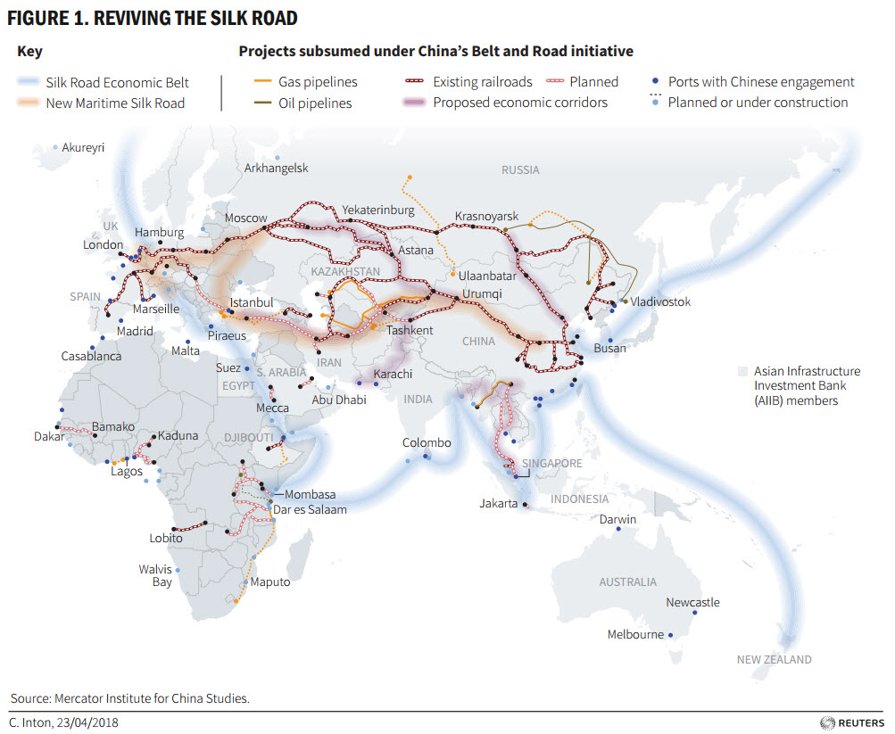
BRI: ‘new silk road’

Slide 4
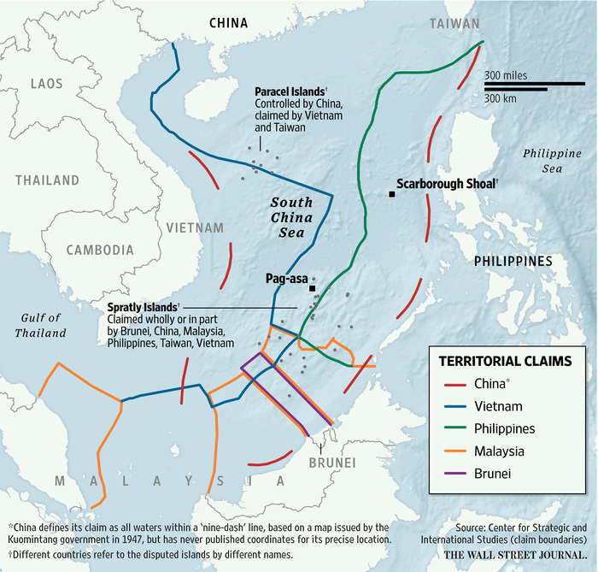
South China Sea: expansion & disputes

Slide 5
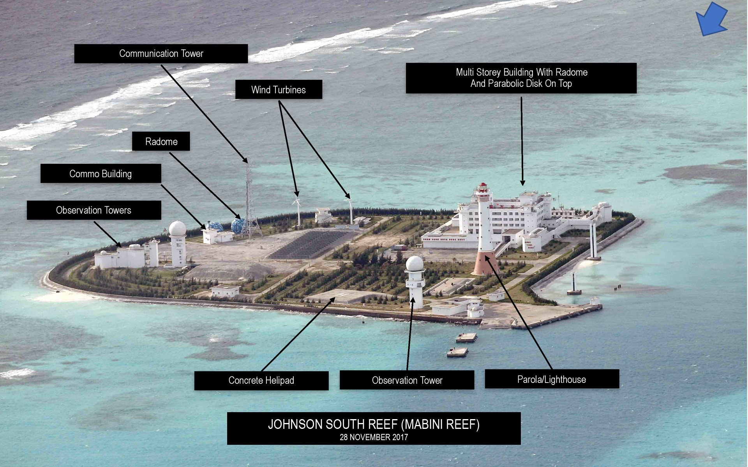
SCS 1

Slide 6
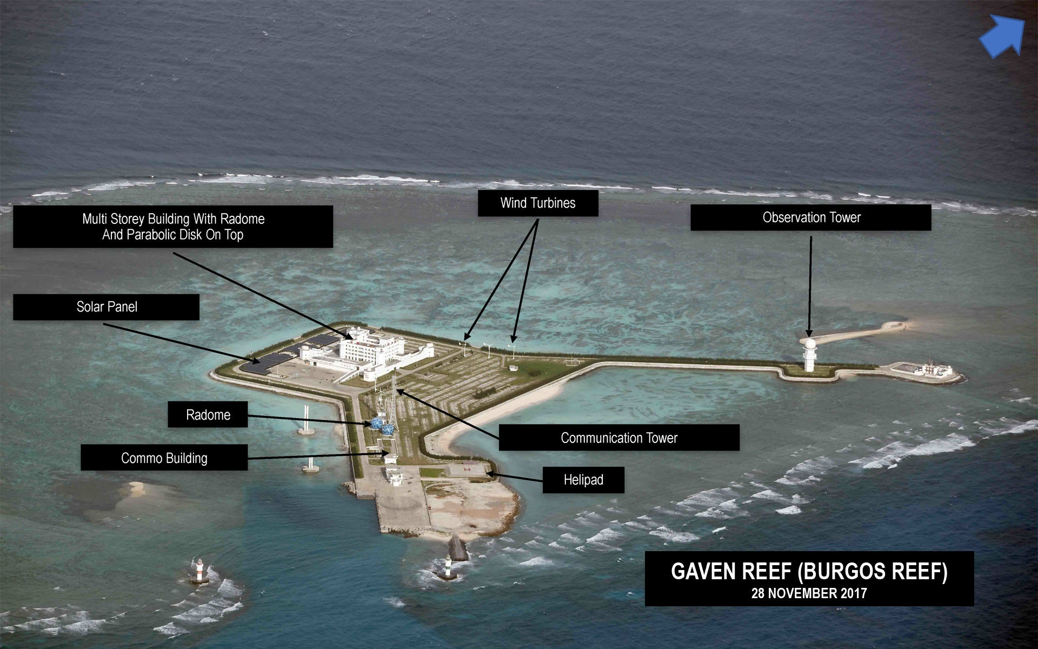
SCS 2

Slide 7
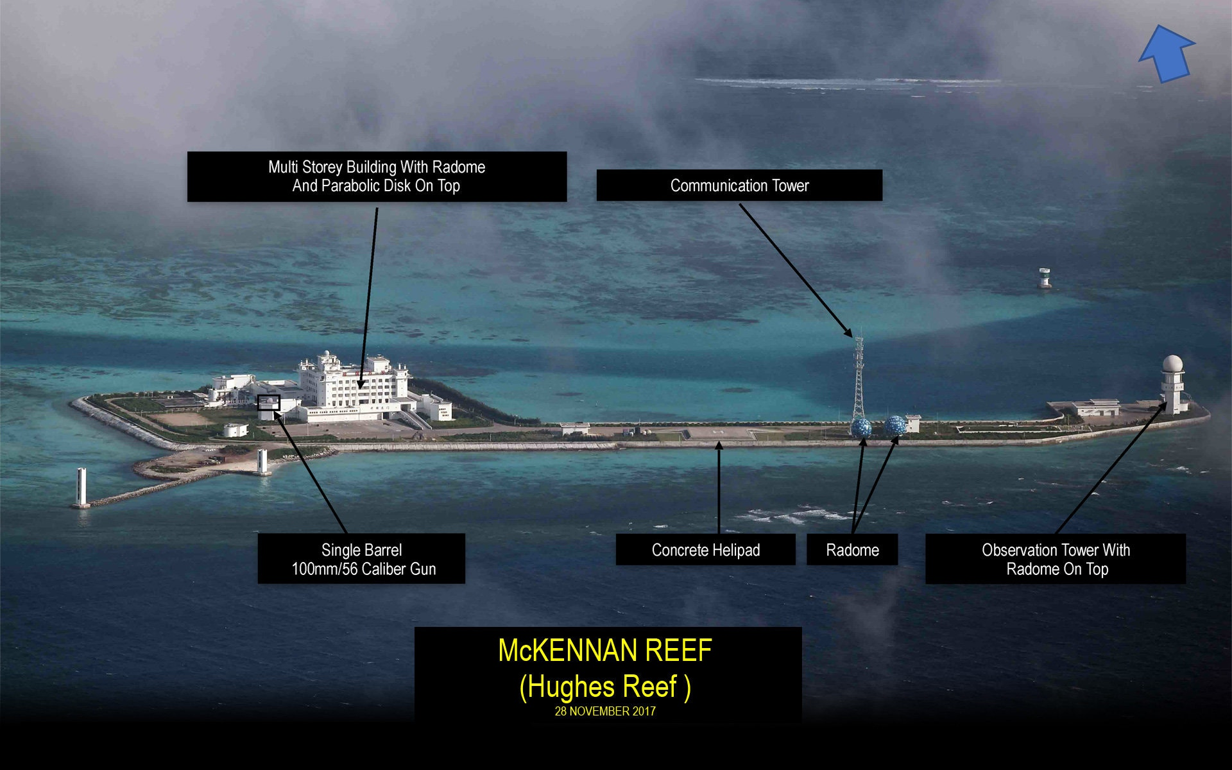
SCS 3

Slide 8
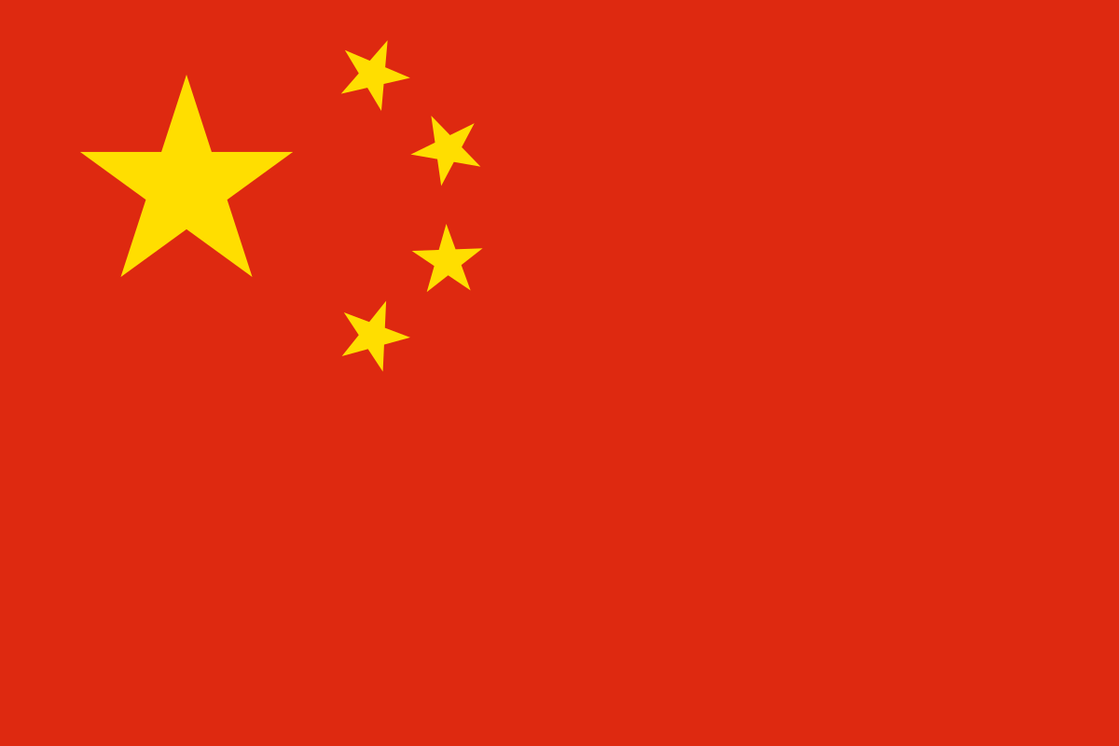
Pro 1: Communist/Chinese Values Good

Slide 9
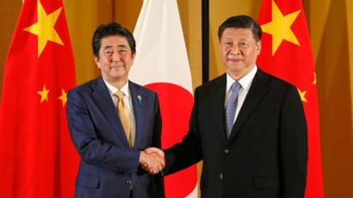
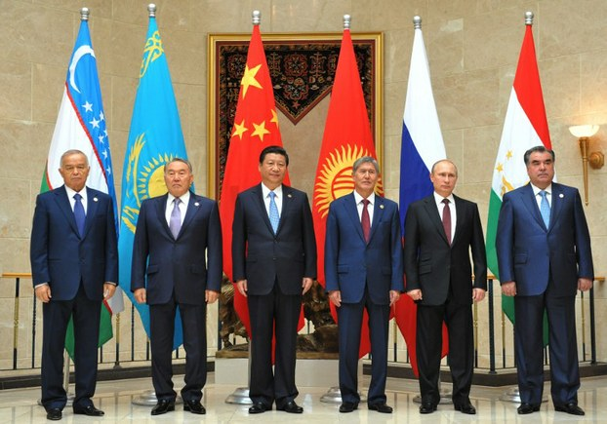
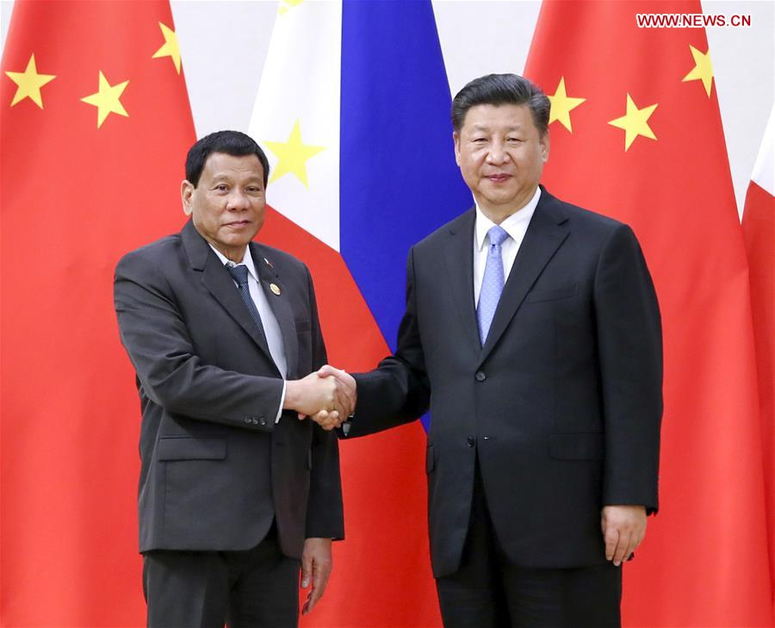
Pro 2: Regional Stability

Slide 10
Pro 3: Integrated Trade

Slide 11
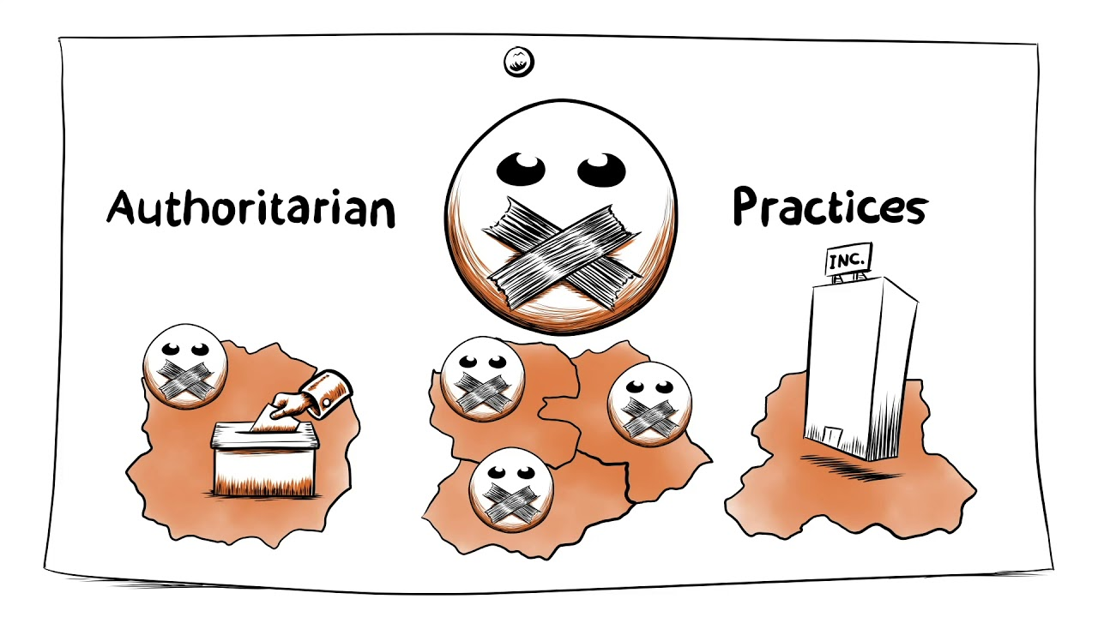
Con 1: CCP Values Bad

Slide 12
Con 2: Surveillance Bad

Slide 13
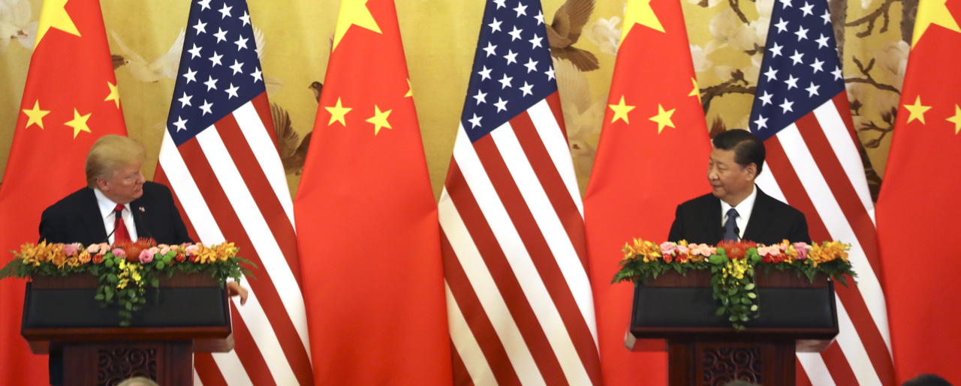
Con 3: Conflict with USA

