Slide 1
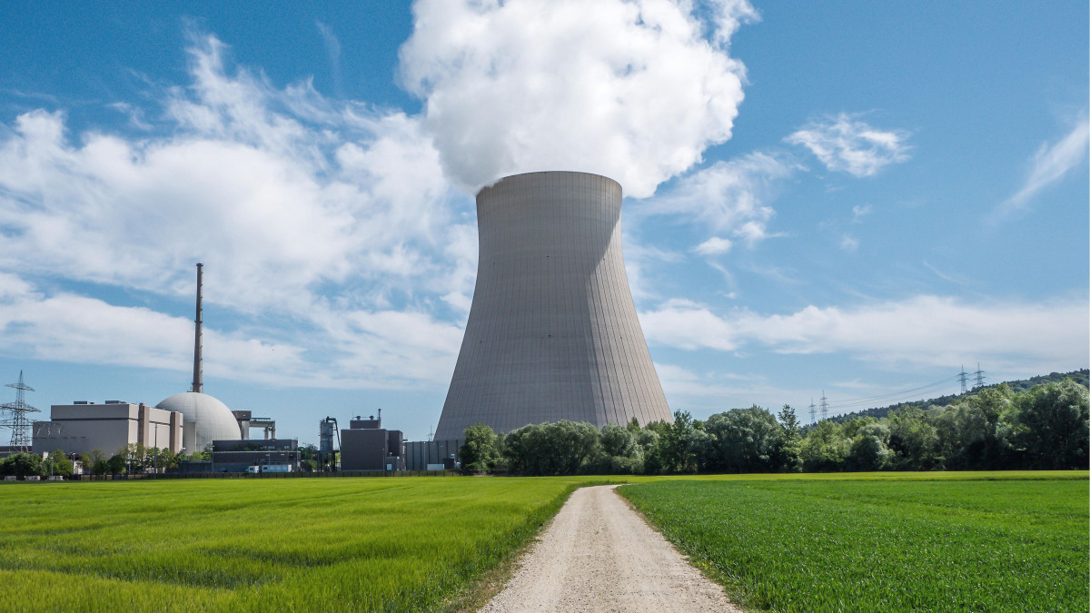
The use of nuclear energy should be significantly expanded.

Slide 2
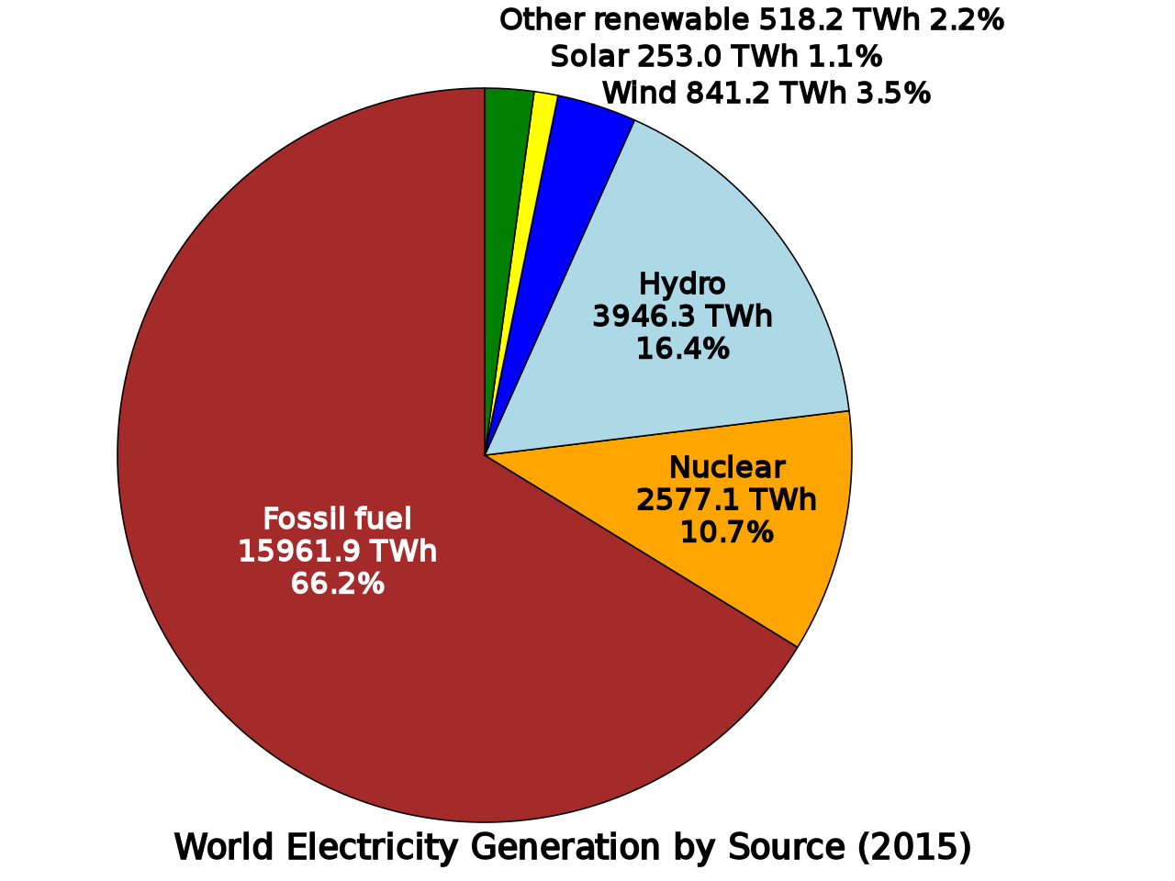
World Energy Use

Slide 3
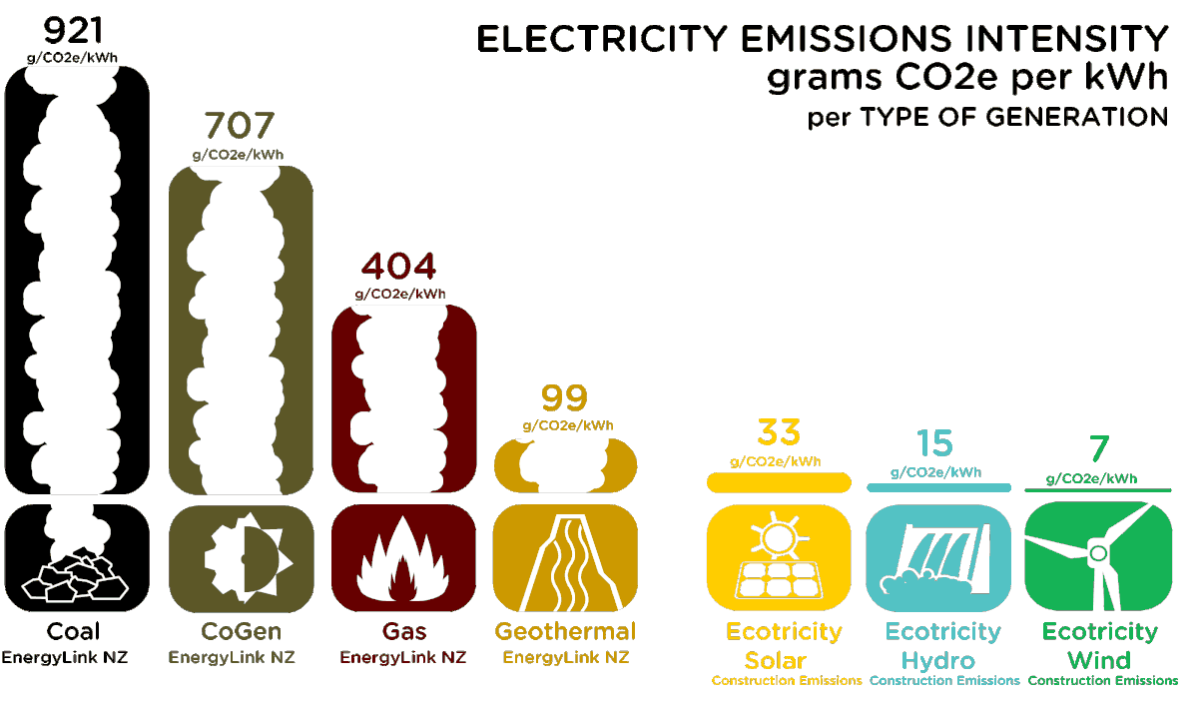
CO2 emissions by power type
Nuclear power: 90-140

Slide 4

A case for nuclear power
Nuclear is:
Clean
  “nuclear still accounts for more than half of all low-carbon energy in the US,
  as the employed nuclear chain reaction itself doesn’t cause CO2 emissions.”
2. Efficient: low mining footprint
3. Safe from meltdowns
  “Consider the triple meltdown of Fukushima Daiichi which failed to lethally affect the more than
  200 helpers that continued to work on site to mitigate damages.”
4. Safe from terrorism
  “current nuclear reactor designs would withstand a
  head-on collision with a fully-fuelled Boeing 767–400”
Daniel Bojar
Synthetic Biology Researcher. Advocating Evidence-Based Policy & Thinking. Fascinated and Inspired by Counterintuitives. @daniel_bojar & dbojar.com

Slide 5
Nuclear vs. Solar & Wind
Nuclear is more:
Consistent
“once it’s finally running, a nuclear reactor is basically permanently producing electricity.
This doesn’t play very well with renewables which deliver highly variable energy (think for instance
solar which only really delivers during the day or hydro which is crippled by drought)”
2. Efficient: lower steel & concrete use
Daniel Bojar
Synthetic Biology Researcher. Advocating Evidence-Based Policy & Thinking. Fascinated and Inspired by Counterintuitives. @daniel_bojar & dbojar.com

Slide 6
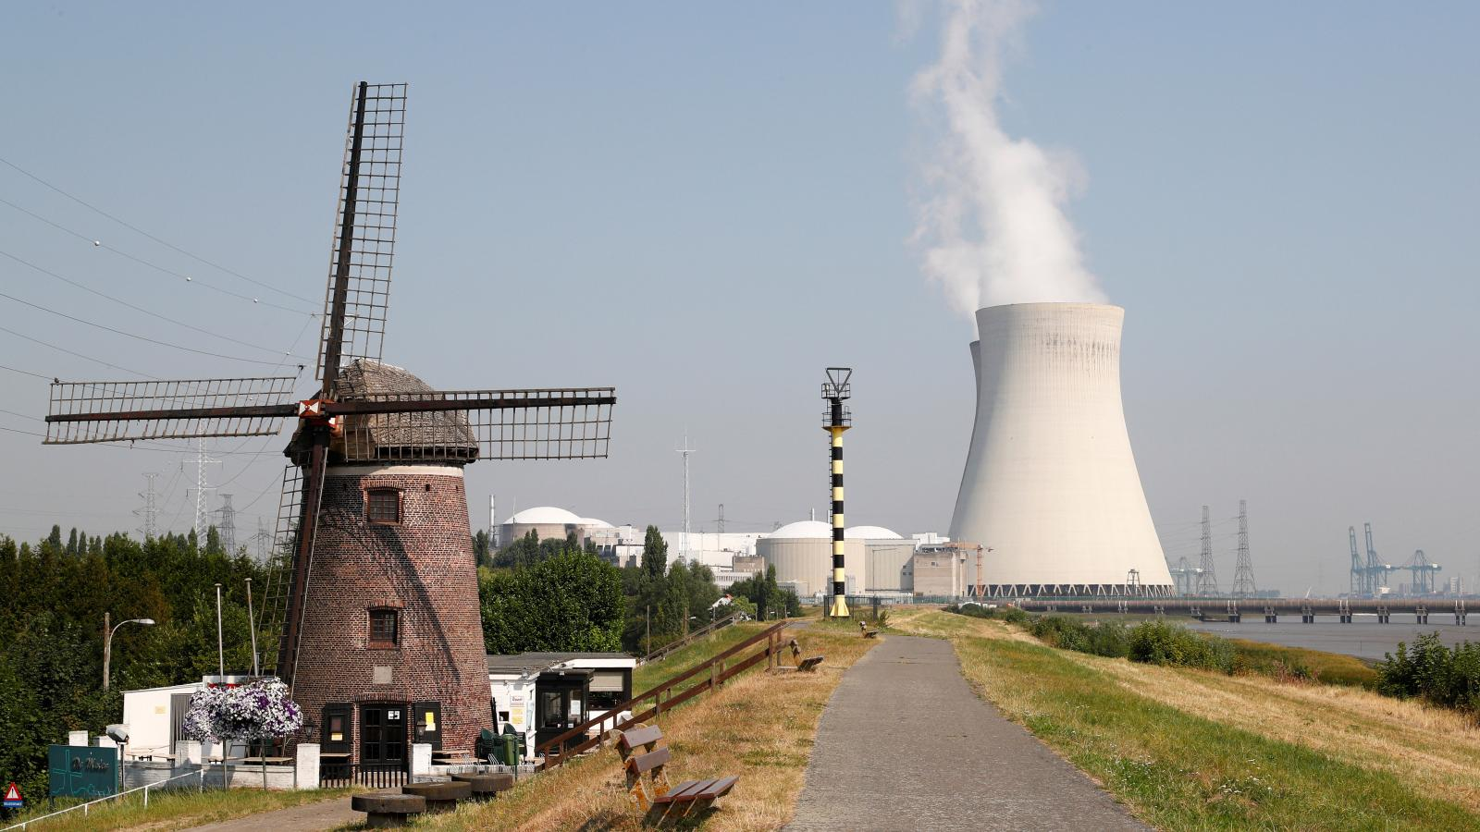
Nuclear isn’t a permanent solution!
“At the current rate of uranium consumption with conventional reactors, the world supply of viable uranium, which is the most common nuclear fuel, will last for 80 years. Scaling consumption up to 15 TW, the viable uranium supply will last for less than 5 years.”
Phys.org. (2019). Why nuclear power will never supply the world's energy needs. [online] Available at: https://phys.org/news/2011-05-nuclear-power-world-energy.html [Accessed 10 Dec. 2019].

Slide 7
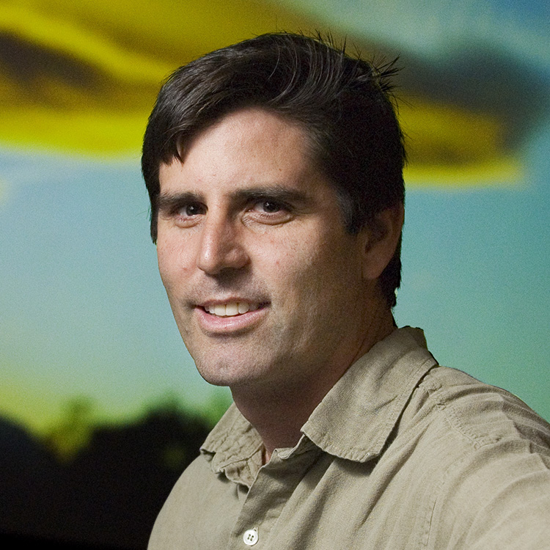
…and a case against
Nuclear:
Takes years to plan & build (10-20 years)
Is expensive ($151/MWh vs. $43/MWh for wind and $41/MWh for solar)
Could lead to proliferation
Meltdown risk
Produce waste that must be contained for up to 200,000 years
Mark Z. Jacobson
Professor of Civil and Environmental Engineering, Director, Atmosphere/Energy Program, Stanford University
https://www.leonardodicaprio.org/the-7-reasons-why-nuclear-energy-is-not-the-answer-to-solve-climate-change/

